Slide 1


Unlock Powerful NLP Tools for Mediation

Slide 2
Session Objectives
Understand how NLP supports mediation
Learn about Chunking Up & Down
Explore the Meta Model
Practice with real scenarios
Notes:
There are other tools, such as rapport building via observation of body, temperature, skin tone, posture etc. - - or mapping out where someone is getting a memory from, like visual or auditory or kinesthetic memory and what their preferred representational system is - then choose those same kind of words, build rapport, for instance . Usually a 1 on 1 session with things like rewriting personal history, overcoming phobias etc.

Slide 3
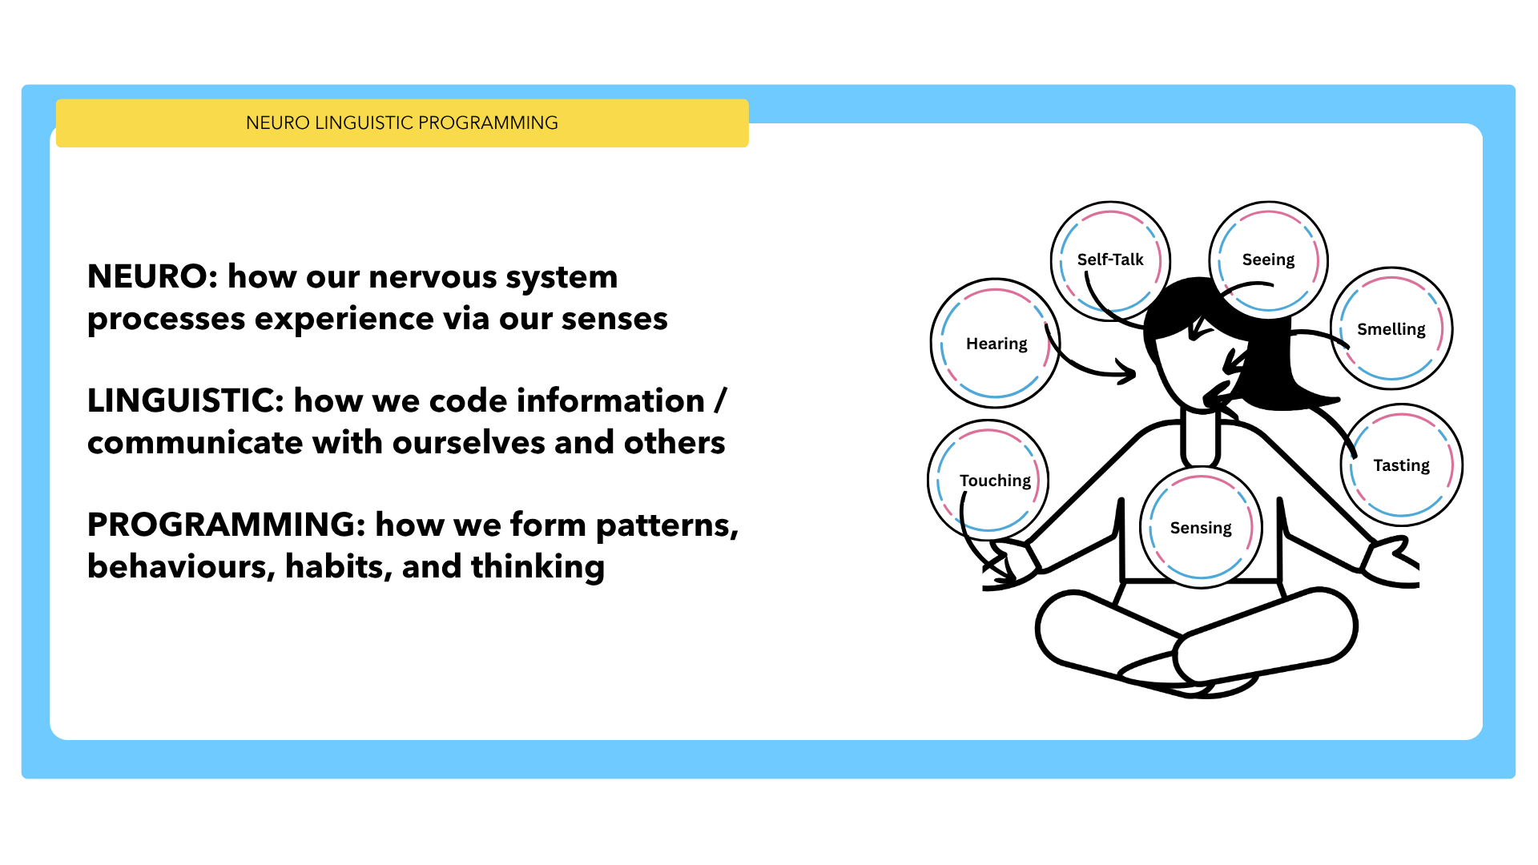
Notes:
Neuro-linguistic programming (NLP) shares similarities with hypnosis and cognitive therapy, and is often integrated with other related approaches, including Mindfulness, Solution-Focused Brief Therapy (SFBT), and Motivational Interviewing (MI).
developed in the 1970s by Richard Bandler (mathematician, computer scientist) and John Grinder (linguist). They created it by "modeling" the techniques of successful therapists like Fritz Perls, Virginia Satir, and Milton Erickson, with the goal of codifying and teaching their methods to others. The first book on NLP was published in 1975, and the field grew in popularity through the 1980s.

Slide 4

Watch on YouTube

Slide 5
Chunking Down
Use when parties are vague or looping
Moving from abstract → concrete
Example questions:
'Can you give me an example?'
'What exactly happened?'

Slide 6
Accusation - Meaning - Need
Chunking Down (clarify the meaning of the comparison)
“What specifically about your partner’s behaviour reminded you of your mother/father?”

Slide 7
Chunking Up
Use when parties are stuck in details
Moving from detail → big picture
Example questions:
'Why is this important to you?'
'What ist the bigger goal?'

Slide 8
Accusation - Meaning - Need
Chunking Up (explore the underlying value or need)
“Why is that particular behaviour or pattern so important or triggering for you?”

Slide 9
Exercise 1: Chunking Practice
1 Mediator, 1 Party
Mediator asks:
- 3 chunk-down questions
- 3 chunk-up questions
Debrief: What shifted?

Slide 10
Exercise: Chunk Up
I can’t work with him, he never listens.
Notes:
“Why is it important for you that he listens?”
“What would a successful working relationship with him look like?”
“How does being listened to affect the way you do your work or feel about the team?”

Slide 11
Exercise: Chunk Down
I can’t work with him, he never listens.
Notes:
“Can you give me a recent example of a time he didn’t listen?”
“What exactly happened in that situation that made you feel unheard?”
“How did you try to communicate your point, and what was his response?”

Slide 12
Who would like to give it a go?
She always puts the kids’ needs above mine.
We can’t agree on anything about money.
I’m drowning in tasks; nothing is clear anymore
She’s always controlling everything.

Slide 13
The Meta Model
Uncovers:
Generalisations
Deletions
Distortions
Useful for clarifying beliefs & meaning
Notes:
The NLP Meta Model helps you challenge the hidden assumptions, distortions, and generalisations in a person’s language so you can uncover the deeper meaning beneath what they’re saying. It brings clarity by guiding people out of their limited “story” and back into direct experience, where real change becomes possible.

Slide 14
Meta Model Examples
'They always ignore me.' → Generalisation
'We can’t fix this.' → Deletion
'It’s obvious.' → Distortion
Questions to ask:
“I’m wondering… where did you get that from?/who says?/and who is that specifically?/what stops you”?
Notes:
Ask soft questions, as else it can quickly turn into an interrogation. Keeping it simple - each one of the three categories has linguistic subcategories, for instance Distortions: Mind Reading, Lost Performative, Cause and Effect, Complex Equivalence, Presuppositions, and Generalisations: Universal Quantifiers, Modal Operators, Deletions: Nominalisations, Unspecific Words, Comparative Deletions.

Slide 15
Exercise 2: Meta Model Practice
Identify patterns in sample statements:
is it a Distortion?
a Generalisation?
a Deletion?
Craft one Meta Model question per statement

Slide 16
Exercise 2: Primary Meta Model?
She doesn’t like me.
We have a problem with our communication.
He never talks to me.
Everything I do ends up being criticised.
It’s bad to be dishonest.
That’s not possible!
Notes:
1- Distortion. How do you know she doesn’t like you?
2- Deletion. How would you like to communicate? What specific problem is there? How do you know it is a problem?
3- Generalisation. Never, ever? What would happen if he did?
4- Generalisation. Who, specifically, is criticising your work? Has there been a time recently where your work was not criticised? What exactly was said that felt like criticism? What would not being criticised feel or look like to you?
5- Distortion. Who says it is bad? How do you know it is bad?
6- Deletion (key info missing) AND Distortion (untested conclusion).Deletion: What is not possible? For whom? Under what conditions? Distortion: Have there been situations where it could have been possible? What would need to happen for it to be possible?

Slide 17
Key Takeaways
Use Chunking for clarity & movement (move from accusation to meaning, to need)
Use Meta Model to reveal hidden assumptions and beliefs, and clarify the meaning of what someone is saying.
Small interventions can create big shifts

Slide 18

Thank You
LEADERS IN MEDIATION
Barbara du Preez-Ulmi (IMI, SIMI, IMC, ISM)
www.leaders-in-mediation.com
connect@leaders-in-mediation.com

